Slide 1

Learning Objective
I will factorise algebraic expressions.
Enter quietly, please be ready with the following on your desk:
Whiteboard
Whiteboard marker
Exercise Book
Pencil, pen, ruler and red pen
Diary
Calculator
Device – charged or borrowed from Library before maths

Slide 2


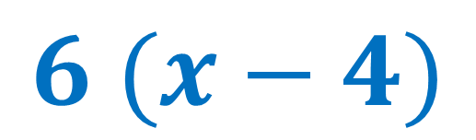
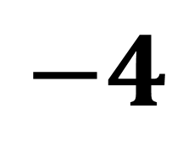

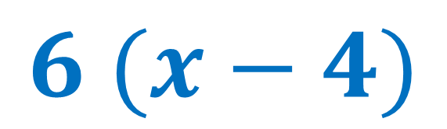


Daily Review
Expand the following expression:
$$6 (x−4)$$
$$6 lots of (x−4)$$
$$x$$
$$−4$$
$$6 (x−4)$$
$$6$$
$$6x$$
$$−24$$
$$=6x−24$$

Slide 3



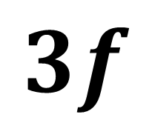
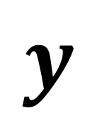

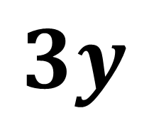

Daily Review
Expand the following expression:
$$3y (y+3f)$$
$$3y lots of (y+3f)$$
$$y$$
$$3f$$
$$3y (y+3f)$$
$$3y$$
$$3y2$$
$$9fy$$
$$=3y2+9fy$$

Slide 4



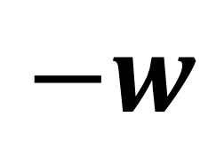


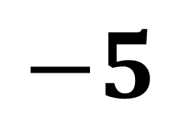

Daily Review
Expand the following expression:
$$−5 (p−w)$$
$$−5 lots of (p−w)$$
$$p$$
$$−w$$
$$−5 (p−w)$$
$$−5$$
$$−5p$$
$$5w$$
$$=−5p+5w$$

Slide 5



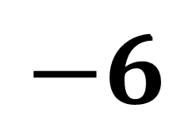





Daily Review
Expand the following expression:
$$9 \left(m−6\right)−4m$$
$$9 lots of \left(m−6\right), then take away 4m$$
$$m$$
$$−6$$
$$9 \left(m−6\right)−4m$$
$$=9m−54−4m$$
$$9$$
$$9m$$
$$−54$$
$$=5m−54$$

Slide 6
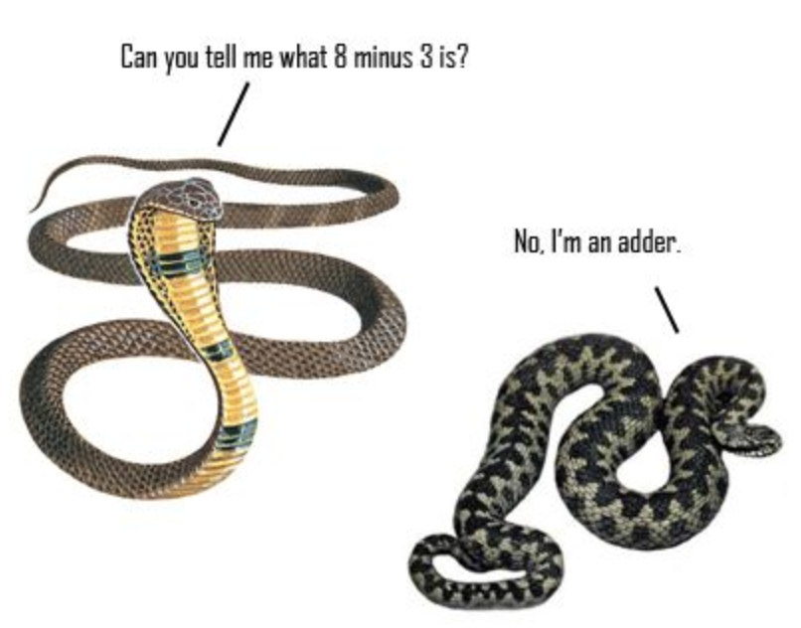
Learning Objective
CFU
What will we learn today?
CFU
I will factorise expressions.
How will you know that you are successful?
Success Criteria
At the end of the lesson, I will be able to:
Factorise expressions by finding the HCF.

Slide 7
Activate Prior Knowledge
CFU 1
What are factors?
Factors are numbers that multiply together to give another number.
EXAMPLE 1:
2 × 3 = 6
1 × 6 = 6
The factors of 6 are 1, 2, 3 and 6.
EXAMPLE 2:
2 × 5 = 10
1 × 10 = 10
The factors of 10 are 1, 2, 5 and 10.

Slide 8
Activate Prior Knowledge
CFU 1
What is the HCF?
The highest common factor (HCF) of two numbers is the largest number that divides into both of the numbers.
EXAMPLE 1:
Find the highest common factor of 4 and 8.
The factors of 4 are 1 2 4
The factors of 8 are 1 2 4 8
The HCF of 4 and 8 is 4.

Slide 9
Activate Prior Knowledge
CFU 1
What is the HCF?
The highest common factor of two numbers is the largest number that divides into both of the numbers.
EXAMPLE 2:
Find the highest common factor 12 and 36.
The factors of 12 are 1 2 3 4 6 12
The factors of 36 are 1 2 3 4 6 9 12 18 36
The HCF of 12 and 36 is 12.

Slide 10


Activate Prior Knowledge
What’s the highest common factor of:
3 and 15 ?
9 and 15?
4 and 14?
6 and 20?
12 and 20?
3
3
2
2
4
$x and 3x$?
$3a and 5a$?
$5xy and 10x$?
$6c and 15c^{2}$ ?
$11a^{2}b and −33ab^{2}$ ?
$$x$$
$$a$$
$$5 x$$
$$3 c$$
$$11 a b$$

Slide 11
Concept Development
CFU 1
What is the difference between expanding and factorising?
Factorising Expressions
Expanding is the process where you remove the brackets.
Factorising is the reverse (you are putting the brackets in).

Slide 12
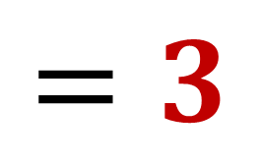











Concept Development
CFU 1
How do we expand an expression?
What is the HCF of the two terms?
What is the term divided by the HCF?
The HCF of $3t$ and 15 is 3.
$$3t÷3=t$$
CFU 2
How do we factorise an expression?
$$15÷3=5$$
$$3t+15$$
Vocabulary
Expanding Factorising
$$t$$
$$5$$
$$3t+15$$
$$3$$
$$3t$$
$$15$$
$$=3$$
$$(t+5)$$

Slide 13
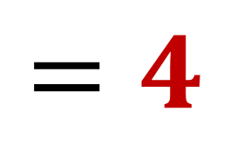








Skill Development/Guided Practice
CFU 1
How do we expand an expression?
Find the HCF of the two terms.
Divide the term by the HCF.
CFU 2
How do we factorise an expression?
$$4t+20$$
Vocabulary
Expanding Factorising
$$t$$
$$5$$
$$4t+20$$
$$4$$
$$4t$$
$$20$$
$$=4$$
$$(t+5)$$

Slide 14








Skill Development/Guided Practice
CFU 1
How do we expand an expression?
Find the HCF of the two terms.
Divide the term by the HCF.
CFU 2
How do we factorise an expression?
$$10t+80$$
Vocabulary
Expanding Factorising
$$t$$
$$8$$
$$10t+80$$
$$10$$
$$10t$$
$$80$$
$$=10$$
$$(t+8)$$

Slide 15
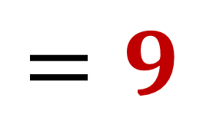




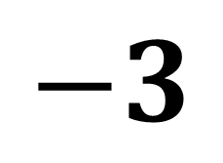


Guided Practice
CFU 1
How do we expand an expression?
Find the HCF of the two terms.
Divide the term by the HCF.
CFU 2
How do we factorise an expression?
$$9t−27$$
Vocabulary
Expanding Factorising
$$t$$
$$−3$$
$$9t−27$$
$$9$$
$$9t$$
$$−27$$
$$=9$$
$$(t−3)$$

Slide 16
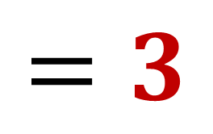



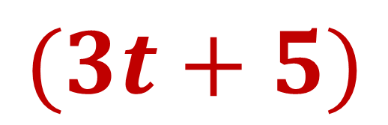
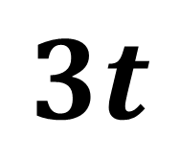

Skill Development/Guided Practice
CFU 1
How do we expand an expression?
Find the HCF of the two terms.
Divide the term by the HCF.
CFU 2
How do we factorise an expression?
$$9t+15$$
Vocabulary
Expanding Factorising
$$3t$$
$$5$$
$$9t+15$$
$$3$$
$$9t$$
$$15$$
$$=3$$
$$(3t+5)$$

Slide 17
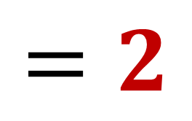





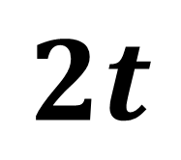

Skill Development/Guided Practice
CFU 1
How do we expand an expression?
Find the HCF of the two terms.
Divide the term by the HCF.
CFU 2
How do we factorise an expression?
$$4t+14$$
Vocabulary
Expanding Factorising
$$2t$$
$$7$$
$$4t+14$$
$$2$$
$$4t$$
$$14$$
$$=2$$
$$(2t+7)$$

Slide 18
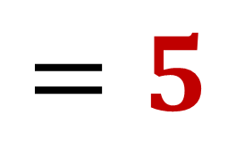



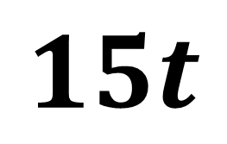
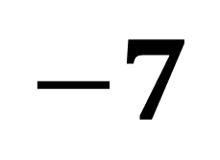

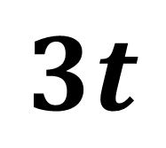

Skill Development/Guided Practice
CFU 1
How do we expand an expression?
Find the HCF of the two terms.
Divide the term by the HCF.
CFU 2
How do we factorise an expression?
$$15t−35$$
Vocabulary
Expanding Factorising
$$3t$$
$$−7$$
$$15t−35$$
$$5$$
$$15t$$
$$−35$$
$$=5$$
$$(3t−7)$$

Slide 19

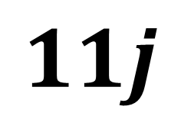



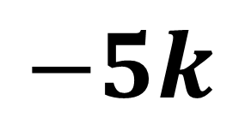



Skill Development/Guided Practice
CFU 1
How do we expand an expression?
Find the HCF of the two terms.
Divide the term by the HCF.
$$22j−55jk$$
CFU 2
How do we factorise an expression?
Vocabulary
Expanding Factorising
$$2$$
$$−5k$$
$$22j−55jk$$
$$11j$$
$$22j$$
$$−55jk$$
$$=11j$$
$$(2−5k)$$

Slide 20

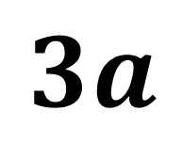

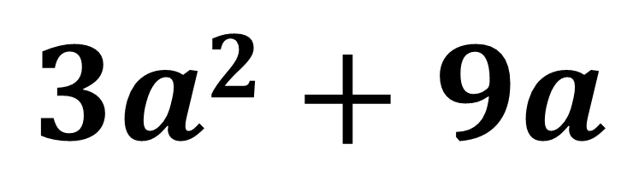


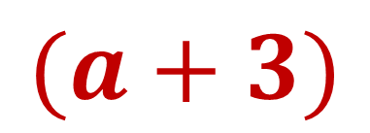


Skill Development/Guided Practice
CFU 1
How do we expand an expression?
Find the HCF of the two terms.
Divide the term by the HCF.
CFU 2
How do we factorise an expression?
$$3a2+9a$$
Vocabulary
Expanding Factorising
$$a$$
$$3$$
$$3a2+9a$$
$$3a$$
$$3a2$$
$$9a$$
$$=3a$$
$$(a+3)$$

Slide 21

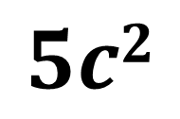
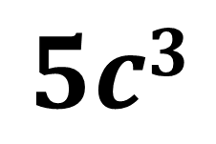

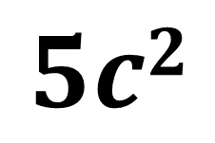




Skill Development/Guided Practice
CFU 1
How do we expand an expression?
Find the HCF of the two terms.
Divide the term by the HCF.
$$5c2+5c3$$
CFU 2
How do we factorise an expression?
Vocabulary
Expanding Factorising
$$1$$
$$c$$
$$5c2+5c3$$
$$5c2$$
$$5c3$$
$$5c2$$
$$=5c2$$
$$(1+c)$$

Slide 22

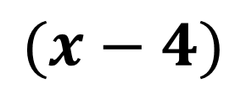
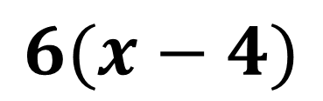
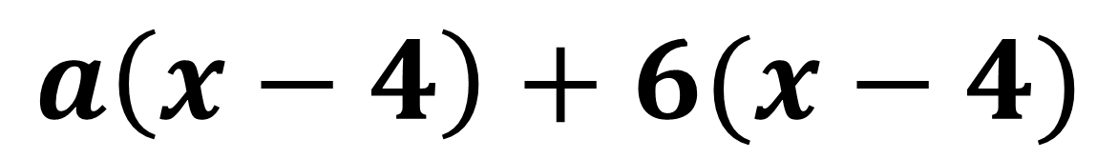
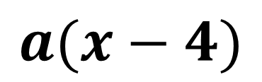




Skill Development/Guided Practice
CFU 1
How do we expand an expression?
Find the HCF of the two terms.
Divide the term by the HCF.
CFU 2
How do we factorise an expression?
$$a\left(x−4\right)+6(x−4)$$
Vocabulary
Expanding Factorising
$$a$$
$$6$$
$$a\left(x−4\right)+6(x−4)$$
$$(x−4)$$
$$a(x−4)$$
$$6(x−4)$$
$$=(x−4)$$
$$(a+6)$$

Slide 23
Independent Practice
Pearson 10 Ex. 3.2 page 160 Questions 1, 2 and 3
Mathspace task – Year 10 Mainstream Factorising Expressions CLASSWORK

